Slide 1

RendezViewz
Medium-fi Prototypes
~Life of the watch party~

Slide 2
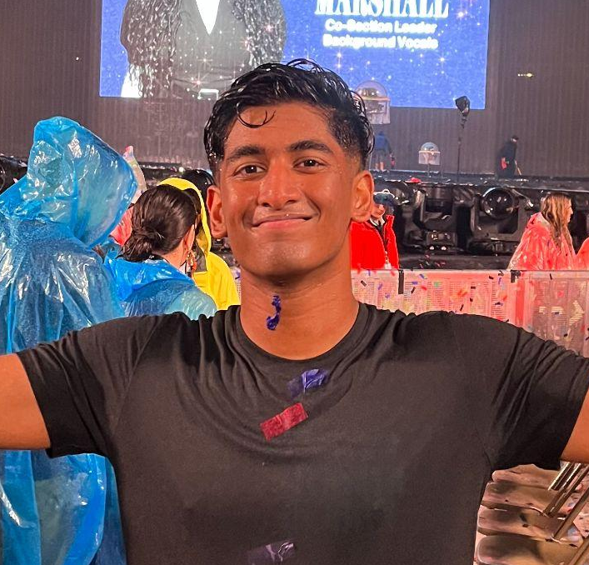
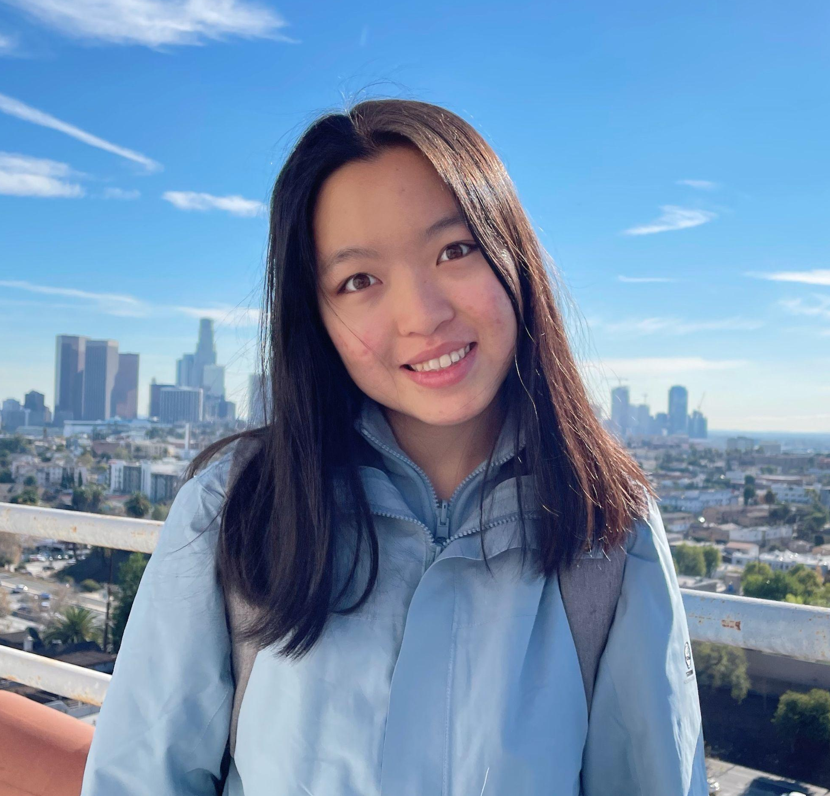
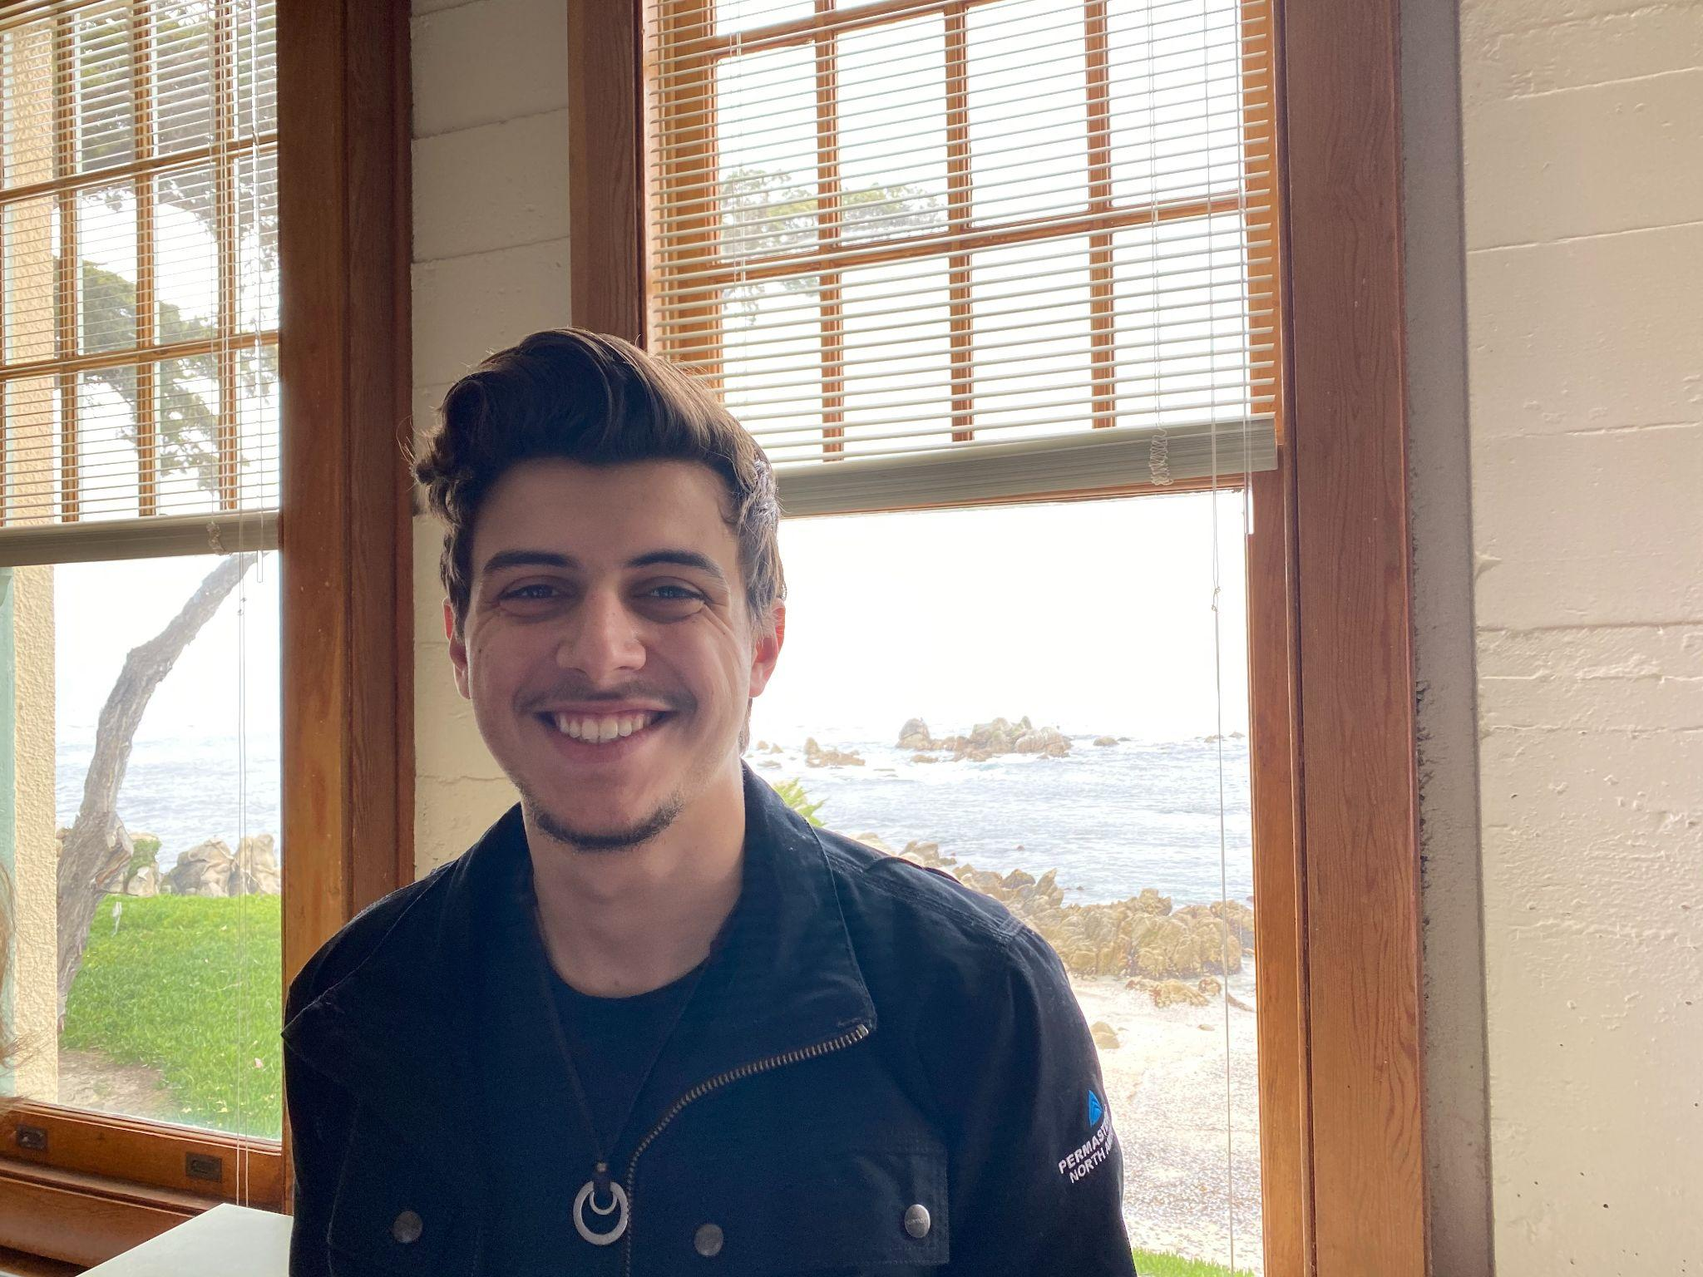
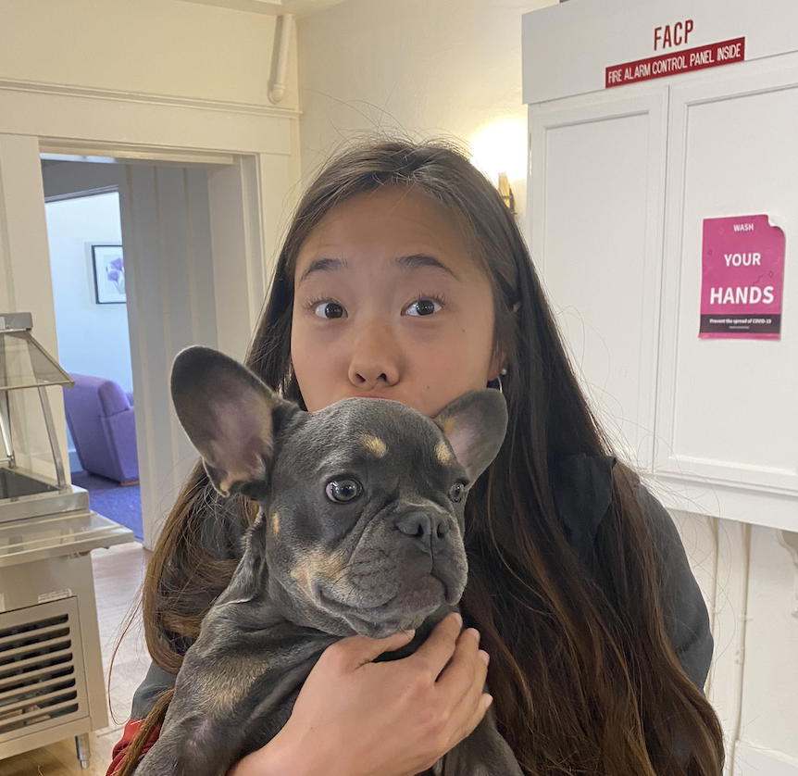
Meet Our Team
Allen Naliath
Charlotte Zhu
Francis Santiago
Yishu Chen
‘25
Boston, MA
‘25
Suzhou, China
‘23/’24
Miami, FL
‘23/’24
Hong Kong

Slide 3
The Problem

Slide 4
The Problem
We realized that people often associate sports with a social watching experience, but not other types of video content.

Slide 5
The Problem
We realized that people often associate sports with a social watching experience, but not other types of video content.
The current solutions in our problem space often involve no space for small, tight-knit social interactions.

Slide 6
The Problem
We realized that people often associate sports with a social watching experience, but not other types of video content.
The current solutions in our problem space often involve no space for small, tight-knit social interactions.
We wanted to help encourage and facilitate meaningful, small-scale social experiences surrounding all types of video content.

Slide 7
The Solution
A media sharing app that leverages the ease and social aspects of listing and ranking shows to engage users and spark interactions surrounding TV/movies . Inspired by friends’ sharings, one can then easily arrange virtual or in-person watch sessions.

Slide 8
Value Proposition
Connect over cinema: Discover, rank, and watch movies and shows seamlessly with friends. Know what they're watching, easily share your favorites, reach out without fear and enjoy together.

Slide 9
Roadmap
01
02
03
Values in Design
Task Overview
Usability Goals &
Key Measurements
04
05
06
Revised Interface Sketches
Medium-Fi
Task Flows
Prototype Implementation

Slide 10
Roadmap
01
Values in Design

Slide 11
Values in Design

Slide 12
Which values are we trying to encode?
Community
Empowerment
Discovery
Enjoyment
01
02
03
04
Give people the means and place to be themselves
Help people find new content from people they trust
Make consuming TV and movies more fun
Facilitate new connections and strengthen old ones

Slide 13
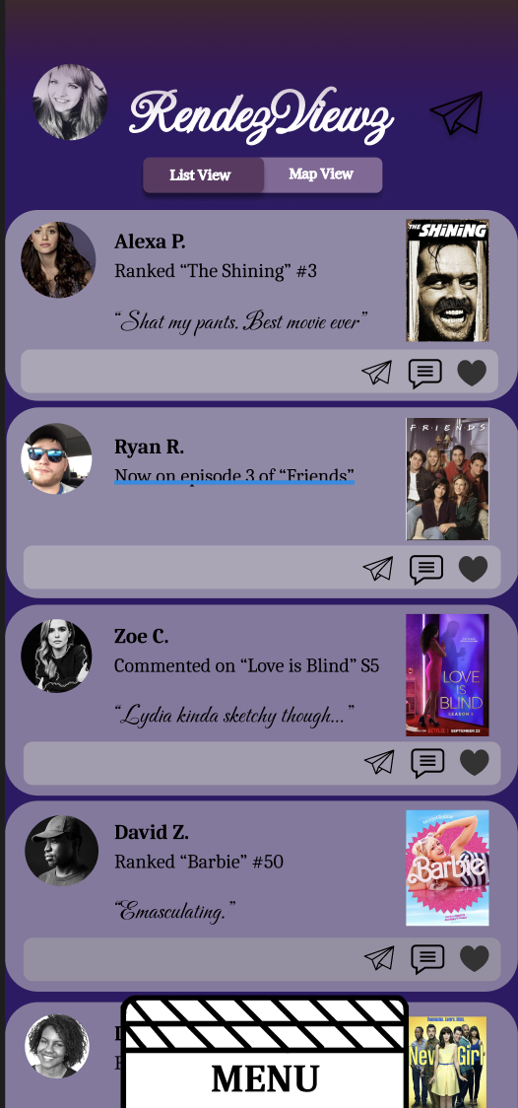
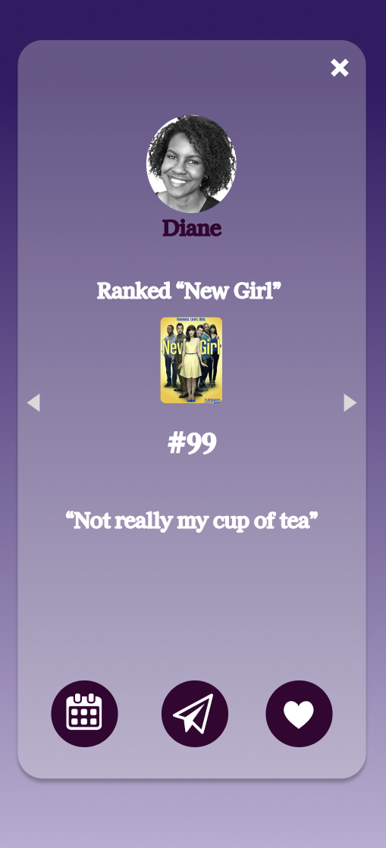
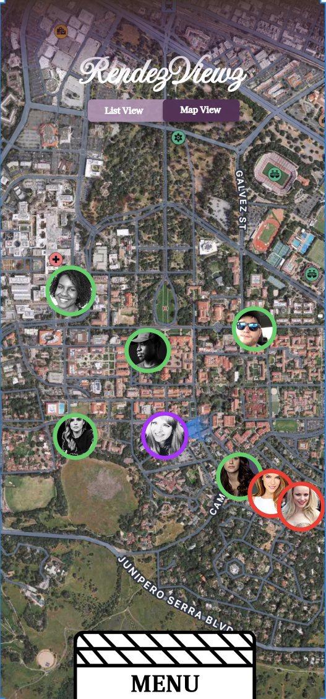
Encoding our values
Facilitating Community
01
Feed and Maps
Friendship management
  Messages
  Scheduling
  Likes

Slide 14
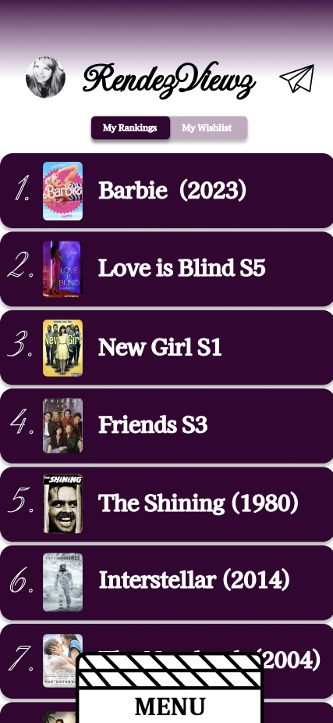
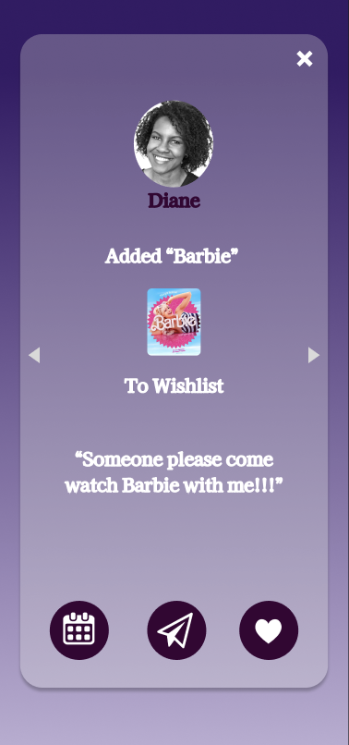
Encoding our values
Empowerment
02
Platform for opinions/ranking
Can see if preferences overlap with friends

Slide 15
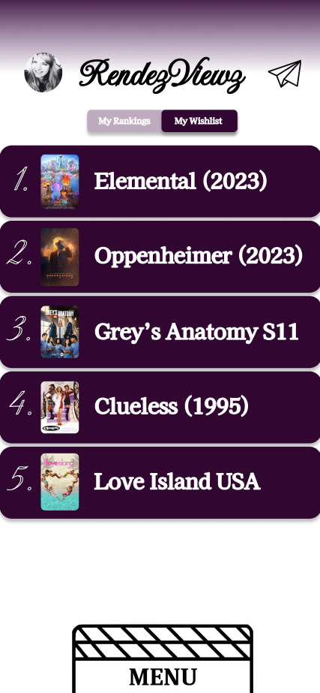
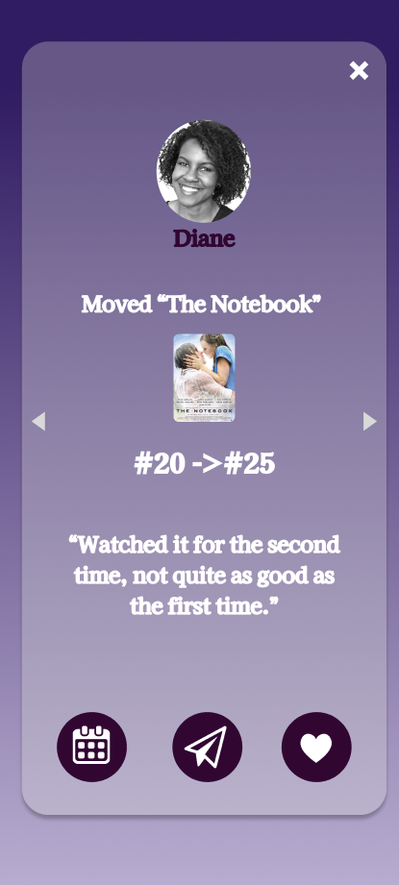
Encoding our values
Discovery
03
Wishlist
Schedule watching new shows with friends
Visible friend rankings

Slide 16
Encoding our values
Enjoyment
04
Facilitates planning fun watching events
Starts engaging conversations around shared preferences

Slide 17
Conflicting Values:
Community & Empowerment
How would a Barbie or New Girl stan feel about updates like these?
Problem
In a space created for community interaction, it can be difficult to feel empowered if other people feel negatively about media that you publicly have ranked highly

Slide 18
Conflicting Values:
Discovery & Enjoyment
Problem
Because discovery requires trying new things, it is likely that the user will encounter media they do not enjoy.

Slide 19
Conflicting Values:
Community & Enjoyment
Huge FOMO opportunity if your friends are watching something together and you didn’t know
Problem
Our app might help some find community, people may feel left out if they are not included in scheduled group watching session.

Slide 20
Roadmap
01
02
Values in Design
Task Overview

Slide 21
Tasks

Slide 22
New Functionality!

Slide 23
In response to feedback from you guys, let RendezView introduce…..

Slide 24
In response to feedback from you guys, let RendezView introduce…..
The Map Feature

Slide 25
In response to feedback from you guys, let RendezView introduce…..
The Map Feature
…And a new feature means, a new task!

Slide 26
New Simple Task:
Access a friend’s recent posts using the Map

Slide 27
Representative Tasks
Simple
Moderate
Complex
Send a message to a friend
Like a friend’s Feed update
Access a friend’s recent posts using the Map
Add a new show to your profile and rank it
Schedule a group watching session 3 months from now

Slide 28
And now for our Task Flow Demo:
View a friend’s recent status updates using the Map

Slide 29

Thank You!
Any Questions?

Slide 30
How well did we achieve our goals?
Efficiency
Learnability
Most users found their way around quite quickly
( < 1 min per page)
Every user quickly used buttons once they found out they were clickable
Some got lost looking for a feature
Flexibility
Enjoyment
⌛
Positive feedback generally
No one hit a dead end
Evidence of desire paths beginning to form
Occasional confusion, but never frustration
Some went in loops but found the right page eventually
⌛
Notes:
Ranking a Show: adding and modifying your ranking list or wishlist
Friend Dynamics: message friends, view their interests, and add friends
Scheduling: view your calendar, create events that others can join, and send invitations to watch movies to others
Movie/Show: see details about movies and shows, details about if and when your friends watched them, how far along they might be, and how they rated the show/any comments they had

Slide 31
How well did we achieve our goals?
Efficiency
Learnability
Most users found their way around quite quickly
( < 1 min per page)
Every user quickly used buttons once they found out they were clickable
Some got lost looking for a feature
Flexibility
Enjoyment
⌛
✅
Positive feedback generally
No one hit a dead end
Evidence of desire paths beginning to form
Occasional confusion, but never frustration
Some went in loops but found the right page eventually
⌛
Notes:
Ranking a Show: adding and modifying your ranking list or wishlist
Friend Dynamics: message friends, view their interests, and add friends
Scheduling: view your calendar, create events that others can join, and send invitations to watch movies to others
Movie/Show: see details about movies and shows, details about if and when your friends watched them, how far along they might be, and how they rated the show/any comments they had

Slide 32
How well did we achieve our goals?
Efficiency
Learnability
Most users found their way around quite quickly
( < 1 min per page)
Every user quickly used buttons once they found out they were clickable
Some got lost looking for a feature
Flexibility
Enjoyment
⌛
✅
Positive feedback generally
No one hit a dead end
Evidence of desire paths beginning to form
Occasional confusion, but never frustration
Some went in loops but found the right page eventually
✅
⌛
Notes:
Ranking a Show: adding and modifying your ranking list or wishlist
Friend Dynamics: message friends, view their interests, and add friends
Scheduling: view your calendar, create events that others can join, and send invitations to watch movies to others
Movie/Show: see details about movies and shows, details about if and when your friends watched them, how far along they might be, and how they rated the show/any comments they had

Slide 33
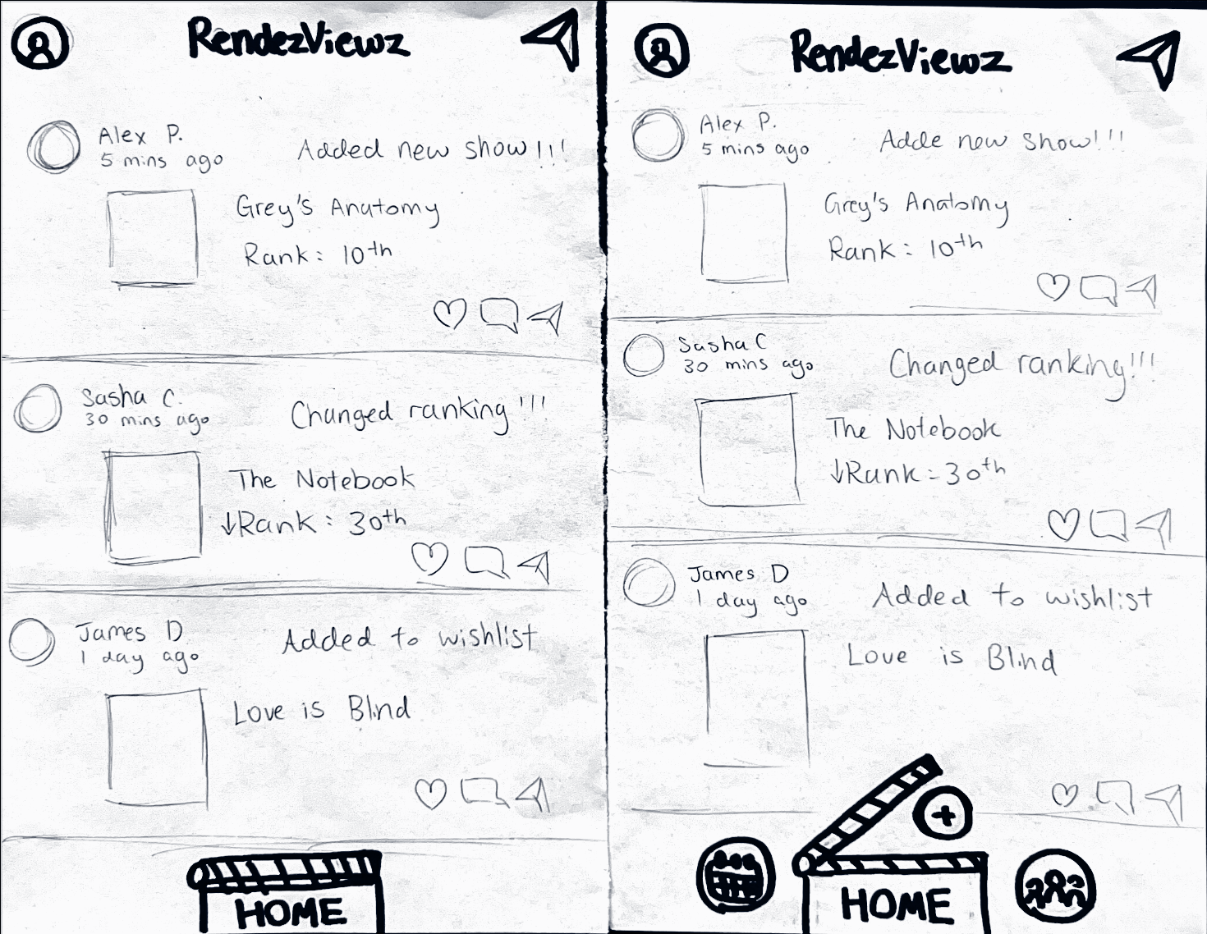
team member roles, description of process
Other Observations
Critical Incident: Getting stuck before finding out the home button was clickable
Notes:
team member roles, description of process

Slide 34
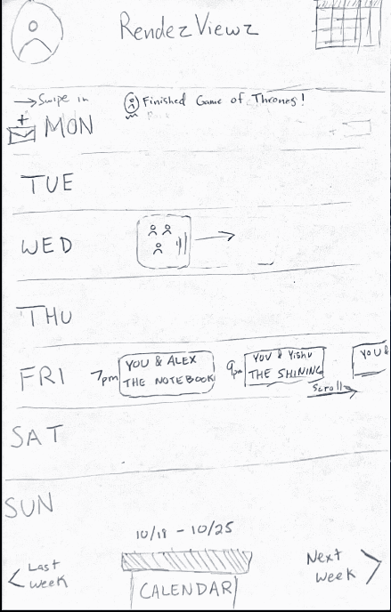
team member roles, description of process
Other Observations
Critical Incident: Getting stuck before finding out the home button was clickable
Critical Incident: Thinking the function of the Home button had changed on a new page
Notes:
team member roles, description of process

Slide 35
team member roles, description of process
Other Observations
Critical Incident: Getting stuck before finding out the home button was clickable
Critical Incident: Thinking the function of the Home button had changed on a new page
General Observation: Sometimes clicking is easier
Notes:
team member roles, description of process

Slide 36
Roadmap
01
02
03
Sketching explorations
Selected interface and rationale
Low-fi prototypes
04
05
06
Testing
methodology
Testing Results
Discussion

Slide 37
Discussion
Notes:
Low-fi prototype construction a. How the prototype was built and operated; its features and interactions 5. Low-fi prototype: 3 task flows a. Simple, moderate, and complex b. Complete and clear with use of captions, labels, transitions, and annotations as required (can use a different color if helpful)

Slide 38
team member roles, description of process
How will we change our design?
Notes:
team member roles, description of process

Slide 39
team member roles, description of process
How will we change our design?
Reworking the home button:
Make it obvious it’s clickable
Keep the “Home” label constant
Notes:
team member roles, description of process

Slide 40
team member roles, description of process
How will we change our design?
Reworking the home button:
Make it obvious it’s clickable
Keep the “Home” label constant
Make logos more obvious:
Some logos are a little vague
People seemed to have many questions
Notes:
team member roles, description of process

Slide 41
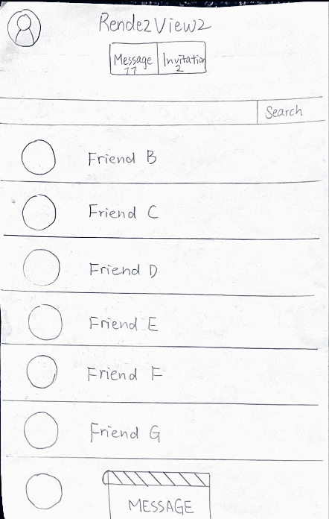
team member roles, description of process
How will we change our design?
Make group creation easier:
Keep flexibility of calendar
But introduce new pathways
Notes:
team member roles, description of process

Slide 42
team member roles, description of process
How will we change our design?
Make group creation easier:
Keep flexibility of calendar
But introduce new pathways
Improve clarity:
Make some options tappables instead of swipes
Improve returning to the home screen
Notes:
team member roles, description of process

Slide 43
Progress towards goals
Efficiency
Learnability
Most users found their way around quite quickly
( < 1 min per page)
Every user quickly used buttons once they found out they were clickable
Some got lost looking for a feature
Flexibility
Enjoyment
No one hit a dead end
✅
Positive feedback generally
Evidence of desire paths beginning to form
Occasional confusion, but never frustration
✅
Notes:
Ranking a Show: adding and modifying your ranking list or wishlist
Friend Dynamics: message friends, view their interests, and add friends
Scheduling: view your calendar, create events that others can join, and send invitations to watch movies to others
Movie/Show: see details about movies and shows, details about if and when your friends watched them, how far along they might be, and how they rated the show/any comments they had

Slide 44
What could our tests have missed?

Slide 45
What could our tests have missed?
More user data could have been collected on navigating through show and movie pages

Slide 46
What could our tests have missed?
More user data could have been collected on navigating through show and movie pages
The app depends on dynamic interactions with friends, and we don’t have a reliable way to simulate that in a Low-Fi prototype

Slide 47
What could our tests have missed?
More user data could have been collected on navigating through show and movie pages
The app depends on dynamic interactions with friends, and we don’t have a reliable way to simulate that in a Low-Fi prototype
How people felt about our design aesthetically

Slide 48
Thank You!
Any Questions?

Slide 49
team member roles, description of process
Appendix
Notes:
team member roles, description of process

Slide 50
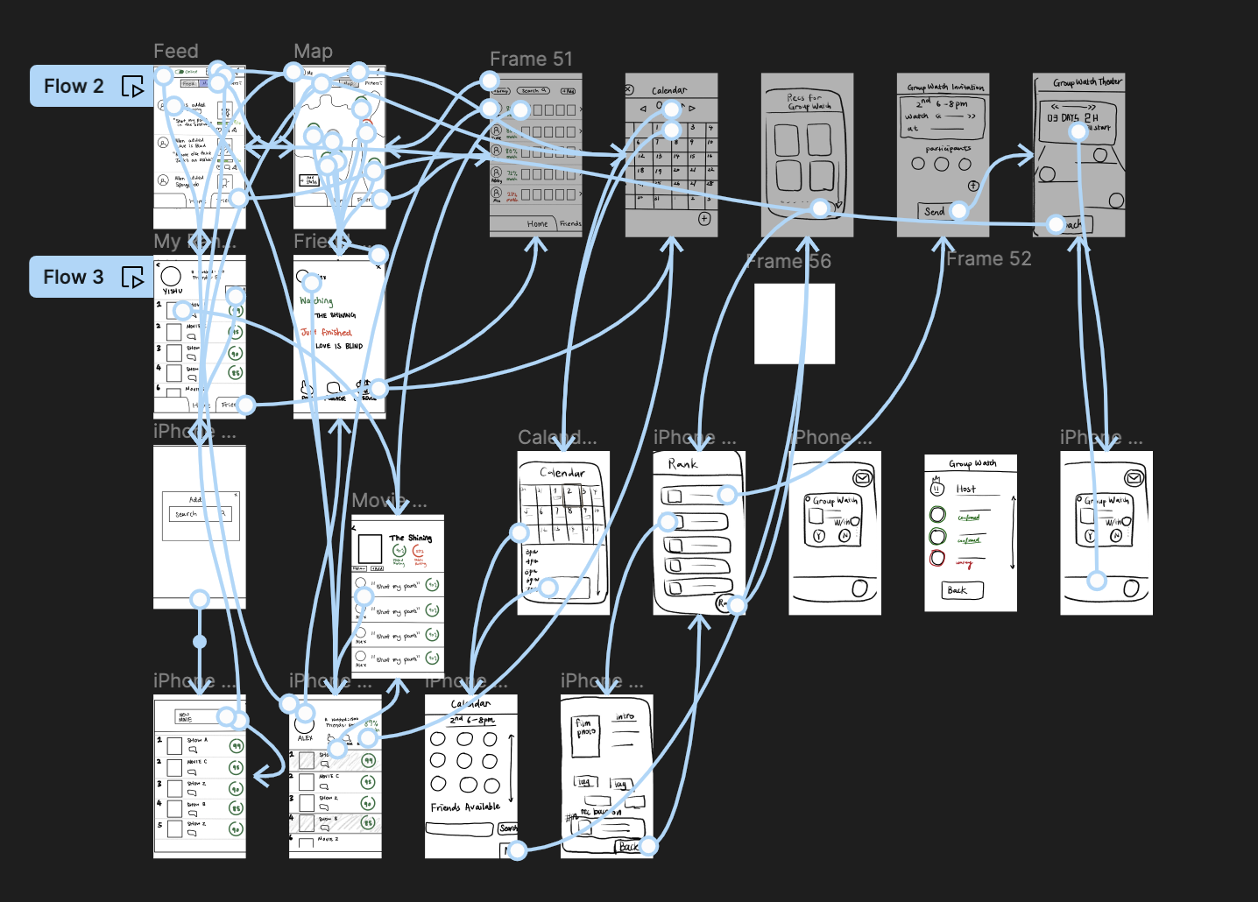
team member roles, description of process
Interview Task Brainstorming
https://www.figma.com/file/UYPUcEVv1uyXLNfaDL3OOI/Rendezviewz?type=design&node-id=0%3A1&mode=design&t=Zy2OBh8zYDzF03NO-1

Slide 51
team member roles, description of process
Interview Task Brainstorming
Task List (easy to hard):
1. Like the first feed post
2. Send a message to a friend not on your feed
3. Add & rank movie
4. Find which season of a show your friend is on
5. Find a friend who wants to see your #1 movie
6. Find a friend who wants to see a specific show on your wishlist
7. Schedule a group watching session three months from now
Notes:
team member roles, description of process

Slide 52
team member roles, description of process
Interview Script
Hi, thank you so much for helping us! Today you will be asked to navigate our very rough draft app. We’ll ask you to attempt a series of tasks. You can pretend that the pieces of paper are like touch phone screens and just click or drag items as you would on a regular phone. We will give you a new sheet of paper for the actions you take to show you the result of your actions. If you’re not sure if something is a button or what its functionalities are, feel free to try or ask for clarifications. It’s totally okay to be very confused and not know what’s going on—we’d love for you to vocalize any thoughts you have, including what you like, what’s clear and what’s confusing. Any questions?
How do you feel about getting started?
Awesome. Let’s start with the first task:
1. Like the first feed post you see
2. Send a message to a friend not on your feed
How about
1. Add & rank movie
Now
1. Find a friend who wants to see a specific show on your wishlist
Last task,
1. Schedule a group watching session three months from now
(After each task: what did think about the task you just completed? What did you struggle with the most? What was clear?)
Awesome job! You have completed all the tasks. Do you have any remaining comments? Thank you so much!
Notes:
team member roles, description of process

Slide 53
Incident Classification
01
If it takes more than 15 seconds to make an action
02
If something not clickable was clicked
03
Confused about button functionality/logo meaning
04
Ask participant for feedback and observe/jot down notes
05
Clicked the wrong button and had to go in a big loop to end up on the right page
06
Clicked the wrong button, went in loops and was unable to complete task without help
Notes:
Reflecting on personal needs and experiences. What domains do we know of that could use innovation?
Stuck between two very different domains. In-depth exploration of both ensued.
Exploration of existing products in entertainment. Using information from interviews to see what needs were most salient.
Identified a gap in existing products and in the needs of the individuals we interviewed. Chose a domain that has the greatest potential for exploration.

Slide 54
Critical Incident Log
Jasmin
Andrew
Athena
Florian
Sean
1
1
2
1
1
1
1
1
3
1
1
1
4
1
1
1
5
1
1
6

Slide 55
Image/icon sources
Brand icons from respective sites.
Like icon: https://pngtree.com/free-png-vectors/like-icon
Plus icon: https://www.iconsdb.com/white-icons/add-icon.html
Calendar icon: https://bearingbrokersinc.com/welcome/calendar-icon-white/
Film icon: https://www.alamy.com/film-icon-in-comic-style-movie-cartoon-vector-illustration-on-white-isolated-background-clapper-video-splash-effect-business-concept-image356270507.html
Podium icon: https://www.vectorstock.com/royalty-free-vector/podium-winners-icon-cartoon-vector-13600701
Popcorn icon: https://www.pinterest.com/pin/french-fries-and-popcorn-clipart-french-fries-and-pop-corn-in-red-paper-box-cartoon--289145238589367362/
Group icon: https://www.vecteezy.com/vector-art/645835-group-people-icon
Eye icon: https://www.vectorstock.com/royalty-free-vector/white-eye-icon-on-black-background-vision-symbol-vector-39347989
Tarot Cards: Tarot Cards of Tech

Slide 56
Credits
This presentation template was created by Slidenest, using resources from these sites:
Images
https://unsplash.com/es/fotos/VnfqkxCSCrU
https://unsplash.com/photos/tZc3vjPCk-Q
https://unsplash.com/photos/pl9DrjAMV6I
https://unsplash.com/es/fotos/TCeSrR11chw
https://unsplash.com/photos/wKOKidNT14w
https://unsplash.com/photos/OpgJPy3zjDE
https://unsplash.com/es/fotos/ZdUNNTZdHag
https://dribbble.com/shots/12047781-Digital-Agency-Hero
https://dribbble.com/shots/21782982-Softphone-App-wip-p2
Fonts
Playfair Display: https://fonts.google.com/specimen/Playfair+Display
Montserrat: https://fonts.google.com/specimen/Montserrat

